Slide 1
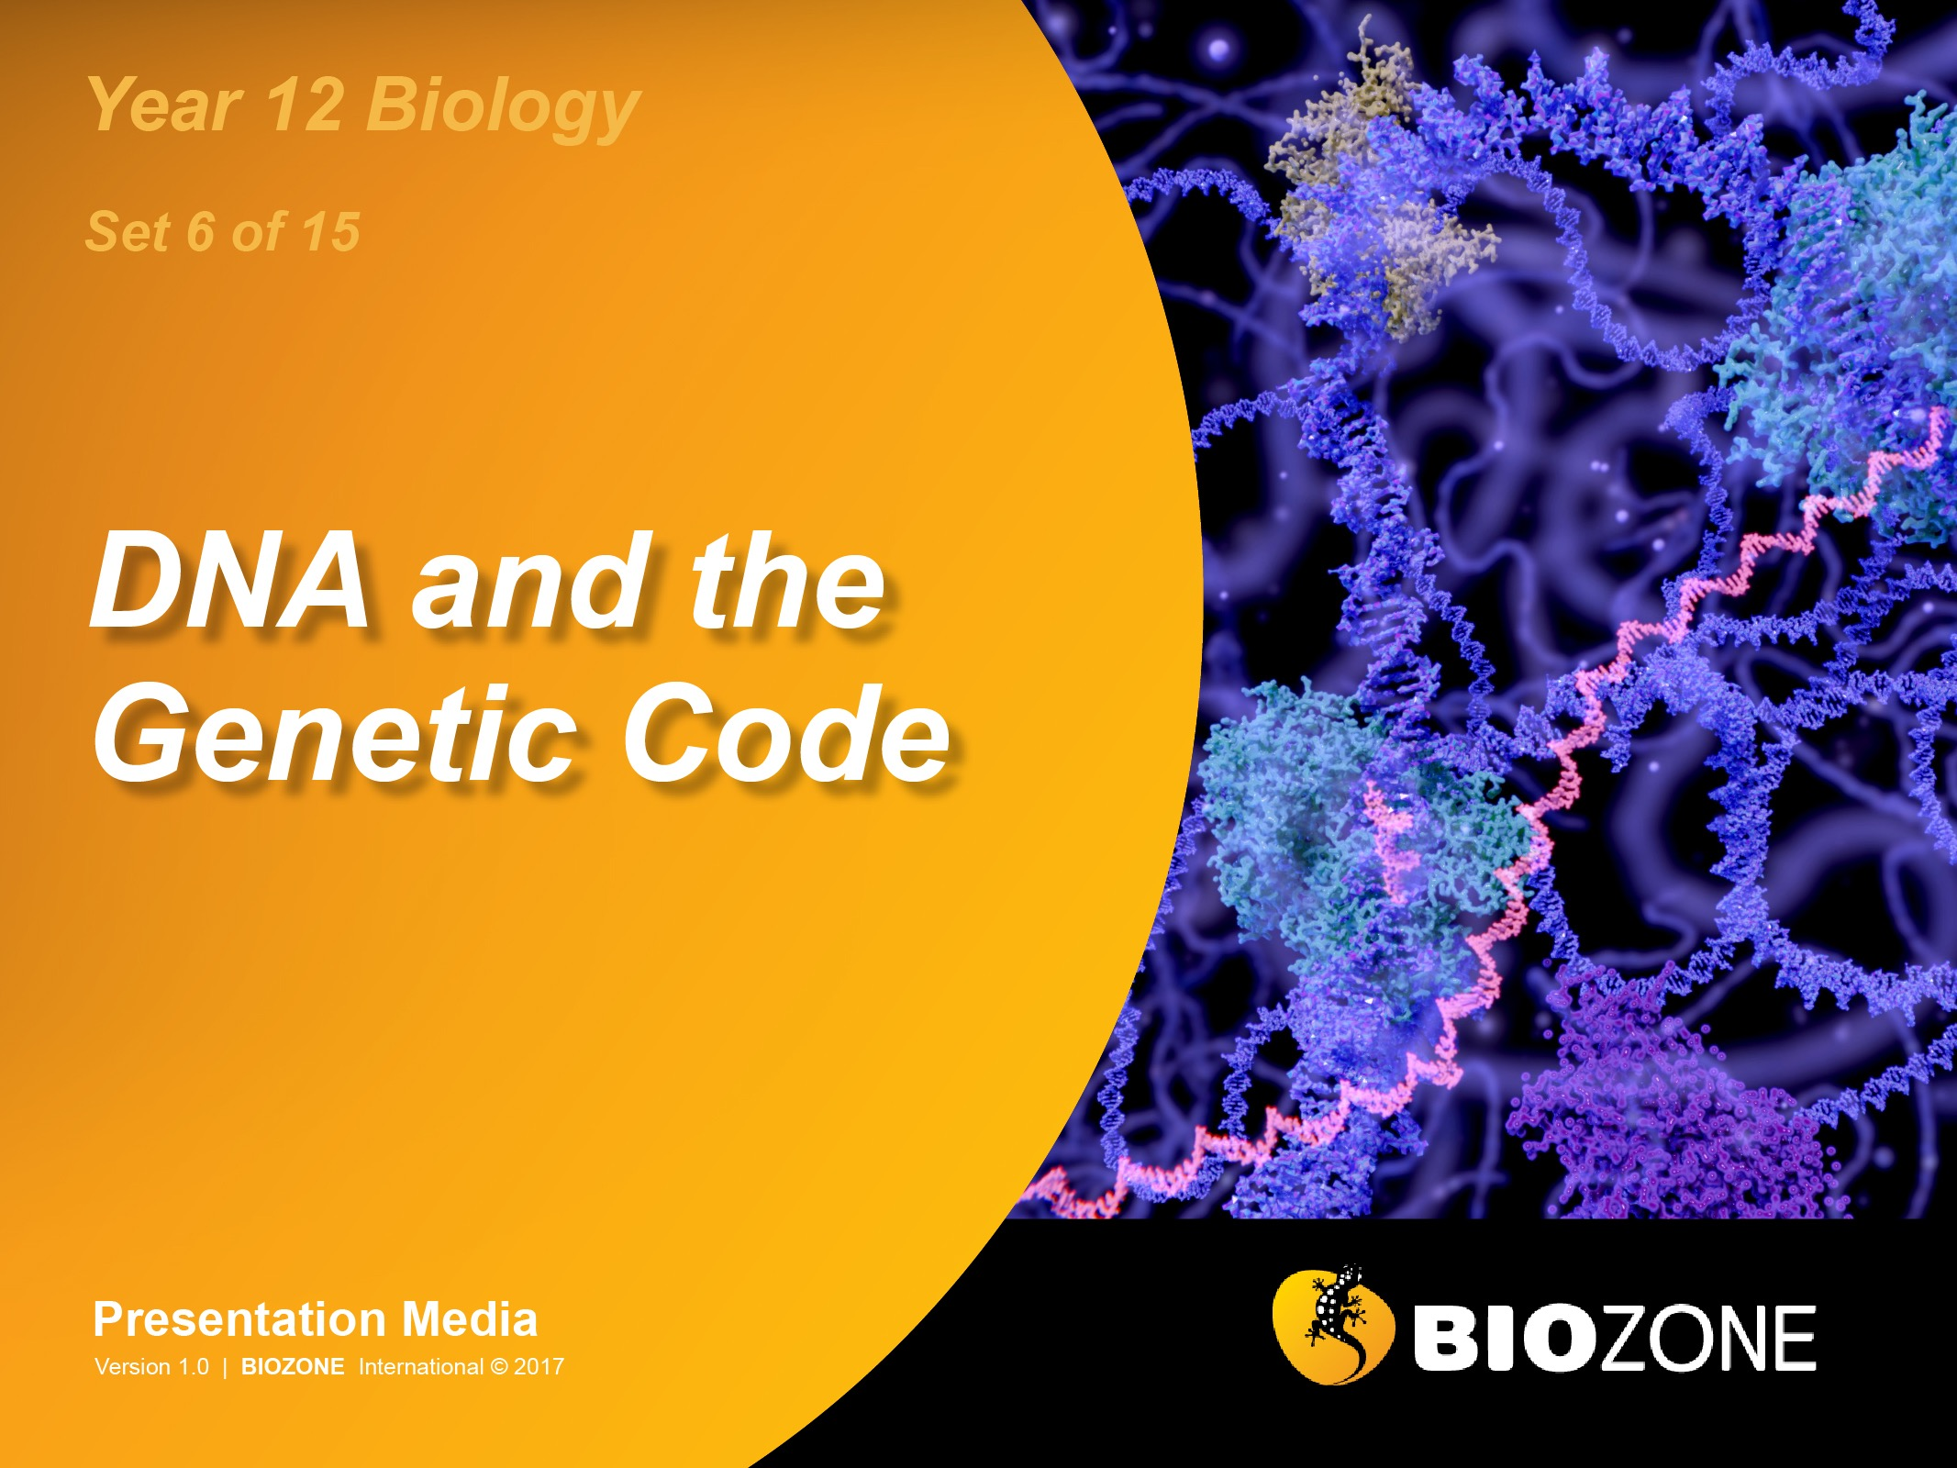

Slide 2
Genomes and DNA
Genomes
Prokaryote chromosomes
Eukaryote chromosomes
Karyotypes
DNA structure
RNA molecules
Gene expression
The genetic code
Gene expression
Transcription
Translation

Slide 3
Genomes
A DNA molecule is very large compared to other molecules.
Even the DNA from the small Polyoma virus is 1.7 µm long (3X longer than the longest protein). Comparisons of the sizes of DNA molecules from different organisms are given on the table below.
Sizes of Genomes
Organism | Genome size | Number of genes
T2 phage | 160,000 bp | 300
Escherichia coli | 4.6 Mb | 4403
Saccharomyces (yeast) | 13 Mb | 6000
Drosophila melanogaster (fruit fly) | 150 Mb | 14,000
Oryza sativa (rice) | 466 Mb | 46,000
Mus musculus (mouse) | 2500 Mb | 30,000
Homo sapiens (humans) | 3000 Mb | 22,500
Paris japonica (Japanese canopy plant) | 149,000 Mb | Unknown

Slide 4
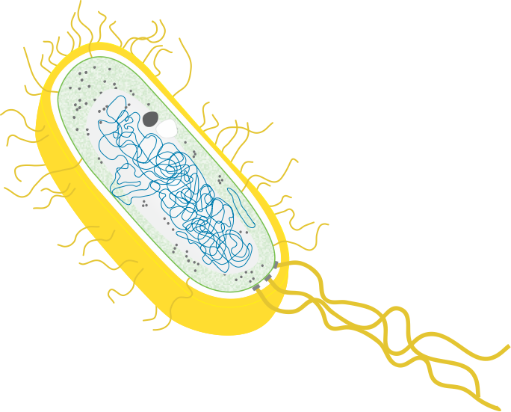
Prokaryotic Chromosomes
Cytoplasmic inclusions include aggregations of storage compounds, e.g. glycogen, fatty acids, sulfur, or phosphorus.
The chromosome is attached to the plasma membrane. Proteins associated with the plasma membrane are responsible for replication. The chromosomal DNA is located in a region of the cytoplasm called the nucleoid. It is not enclosed in a membrane.
Plasmids (small circular auxiliary DNA strands) are also found in the cytoplasm. Plasmids replicate independently of the main chromosome and can move between cells by conjugation.
Most bacteria have a single, circular chromosome. This makes them haploid for most genes, unless copies are located on extra-chromosomal plasmids.

Slide 5
The Bacterial Plasmid
Bacteria commonly contain small circular pieces of DNA called plasmids.
The bacterium Agrobacterium tumefaciens often contains the Ti (tumour inducing) plasmid.
This plasmid is able to transfer genetic material into plant cells and causes crown gall disease.
Several regions on the plasmid help it to infect plants.
The plasmid is just over 200,000 bp long and contains 196 genes.
The mapping of its genes has made it of great importance in the creation of transgenic plants.
Cytokinin production (controls cell division in plants)
Auxin production: interferes with auxin regulated plant development processes
Opine synthesis
Transfer DNA region (integrated into host genome) (20,000 bp)
Border of transfer region
Catabolism of opines (used as a nitrogen and energy source by Agrobacterium)
Virulence region A - H
Origin of replication

Slide 6
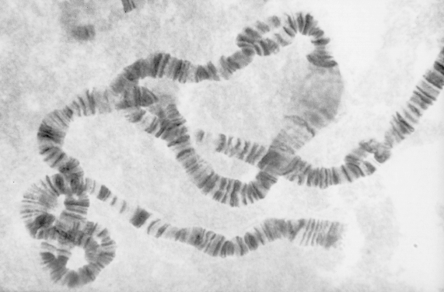
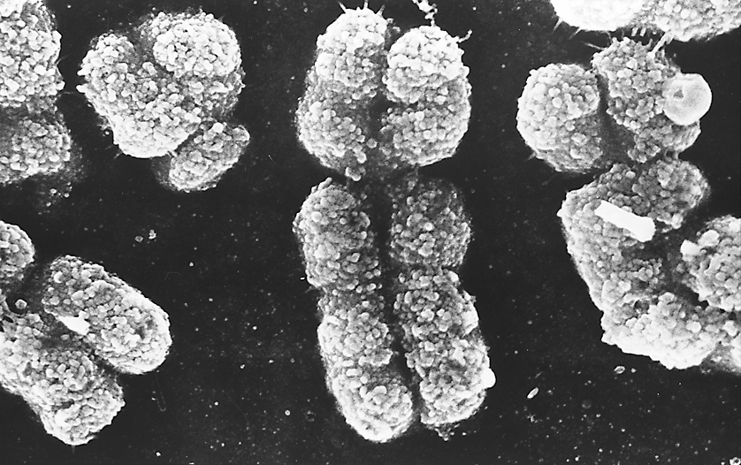
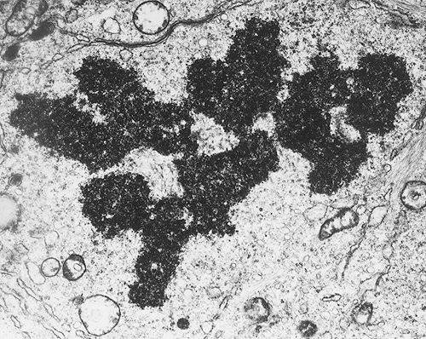
Eukaryotic Chromosomes
Chromosomes are a single long molecule of DNA coiled around histone proteins. They can be viewed in different forms by using a variety of microscopes:
A: Light microscope view of a chromosome from the salivary glands of the fly Simulium.
Banding: groups of genes stained light and dark.
Puffing: areas of transcription (mRNA production).
B: Scanning electron microscope (SEM) view of sex chromosomes in the condensed state during a cell division. Individual chromatin fibres are visible.
The smaller chromosome is the ‘Y’ while the larger one is the X.
C: Transmission electron microscope (TEM) view of chromosomes lined up at the equator of a cell during the process of cell division. These chromosomes are also in the condensed state.
A
Y
X
B
C

Slide 7

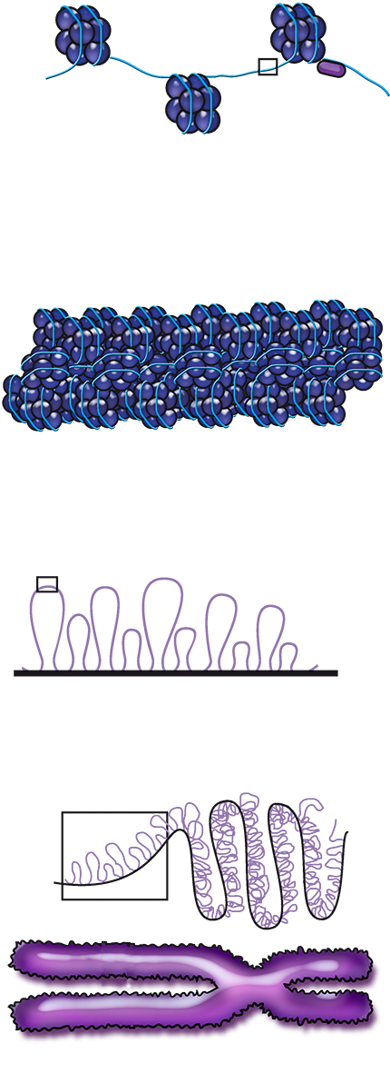
Chromosome Structure
DNA molecule
2 nm
Histone proteins organise the DNA into tightly coiled structures (condensed, visible chromosomes) in the first stage of cell division.
Coiling into compact structures allows the chromatids to separate without tangling during cell division.
The histones are modified in various ways and regulate the activity of the DNA around them.
The genes on the DNA cannot be expressed until the DNA is unwound (unpacked) and becomes accessible to enzymes.
Nucleosomes
10 nm
Nucleosome
Histone beads
Chromatin fibre
30 nm
Looped domains of chromatin fibre
300 nm
Looped and folded domains
700 nm
Metaphase chromosome
1400 nm

Slide 8
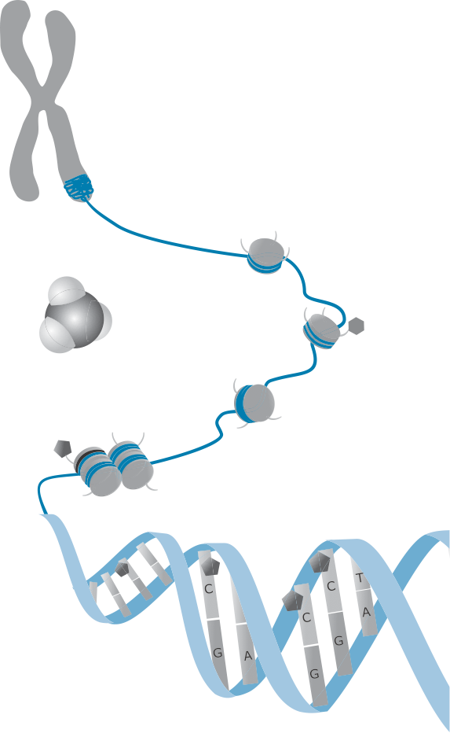
DNA Packaging
Histone modification
Histone modification is an important aspect of the epigenetic control of gene expression. Histones may be modified by methylation or acetylation of the histone tails.
Chromosome
The regulation of gene expression in eukaryotes is a complex process beginning before the DNA is even transcribed.
The packaging of DNA regulates gene expression either by making the nucleosomes in the chromatin pack together tightly (heterochromatin) or more loosely (euchromatin).
This affects whether or not RNA polymerase can attach to the DNA and transcribe the DNA into mRNA.
Acetylation removes the positive charge on the histones, decreasing their interaction with DNA and allowing the chromatin to transform into a more relaxed structure that allows transcription.
Chromatin
Histone tail
Methyl group
Histone
DNA inaccessible, gene inactive
DNA accessible, gene active

Slide 9
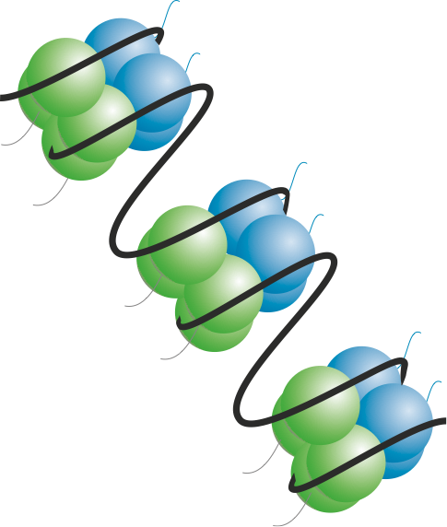
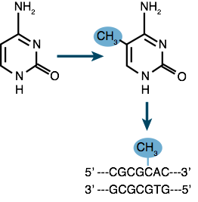
Modifying DNA Packaging
Packaging of DNA is affected by histone modification and DNA methylation.
These modifications alter how the DNA is packaged and determine whether or not a gene can be transcribed.
The modifications (or tags) are called epigenetic ('above genetics’) because they do not involve changes to the DNA sequence itself.
Cytosine methylation is an important process in DNA packaging and gene expression. Cytosine methylation affects gene expression in two ways: it may physically impede the binding of transcription factors or it may cause the chromatin to bind tightly together so that genes cannot be transcribed.
Histones may be modified by a number of processes, including methylation of the histone tail. Depending on the type of modification, the chromatin may pack together more tightly or more loosely, affecting the cell's ability to transcribe genes.

Slide 10
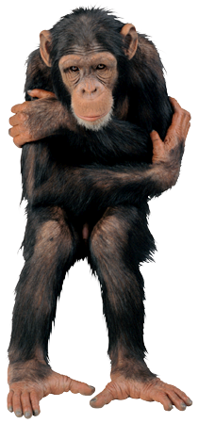

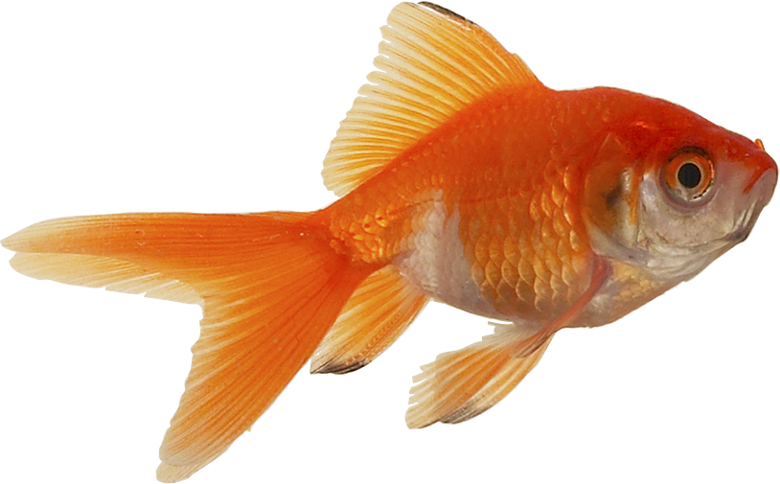
Numbers of Chromosomes
Chromosome numbers vary considerably among organisms.
The numbers may differ markedly even between closely related species.
Organisms | Chromosome No.
Human | 46
Chimpanzee | 48
Gorilla | 48
Cattle | 60
Cat | 38
Goldfish | 94
Drosophila | 8
Honey bee | 32 or 16
Hydra | 32
Cabbage | 18
Beans | 22
Orange | 18, 27 or 36
Garden pea | 14

Slide 11
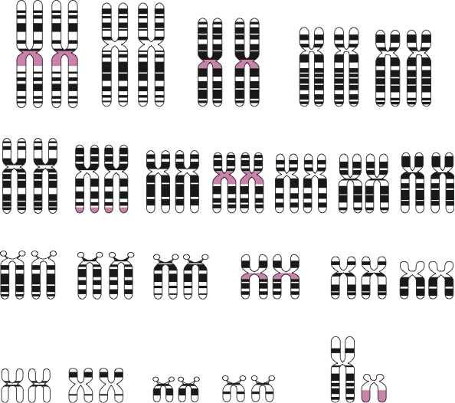
Human Karyotypes
Karyograms display the chromosome contents of a cell, organised according to their number, size and type (right).
Normal somatic human cells have a karyotype with 46 chromosomes (in 23 pairs) comprising:
22 pairs of autosomes.
1 pair of sex chromosomes. These determine the sex of an individual:
XX = female
XY = male
1
2
3
4
5
6
7
8
9
10
11
12
13
14
15
16
17
18
19
20
21
22
Y
X
Sex chromosomes

Slide 12

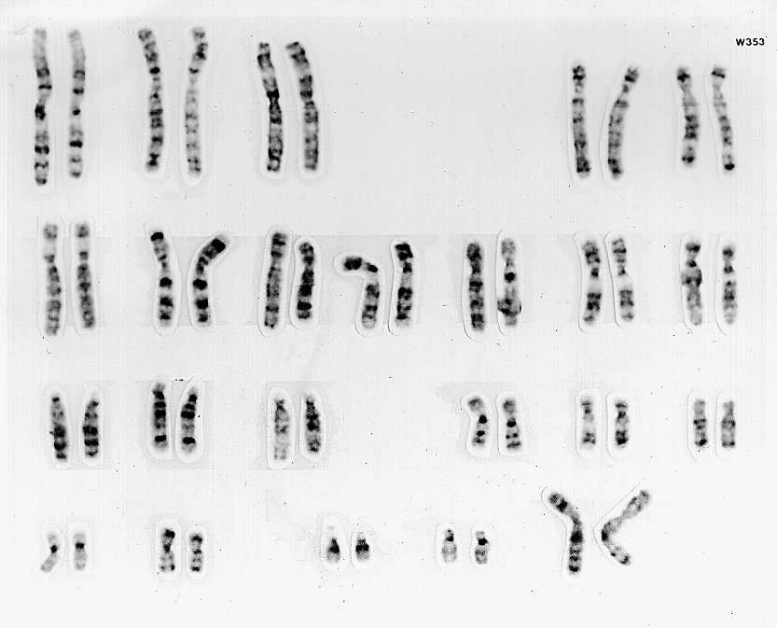
Human Female Karyotype
Every cell (except egg cells) in a normal human female has:
44 autosomes
2 sex chromosomes
Human Female: 46, XX
Sex chromosomes: XX = female

Slide 13

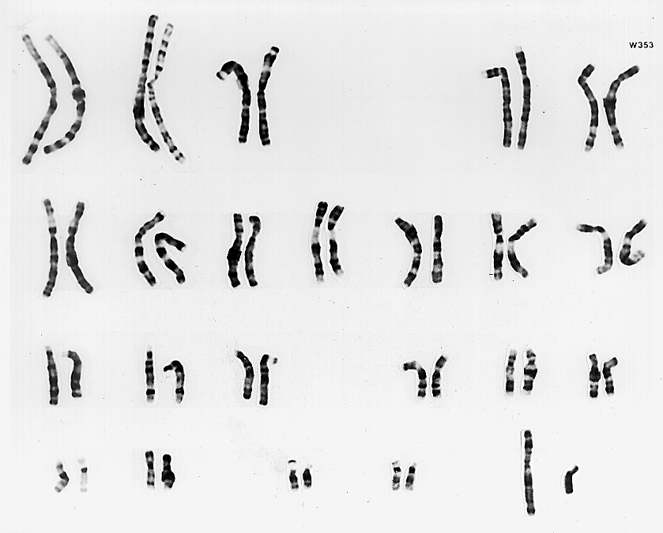
Human Male Karyotype
Every cell (except sperm cells) in a normal human male has:
44 autosomes
2 sex chromosomes
Human Male: 46, XY
Sex chromosomes: XY = male

Slide 14

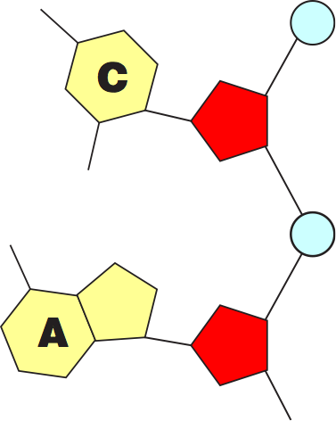
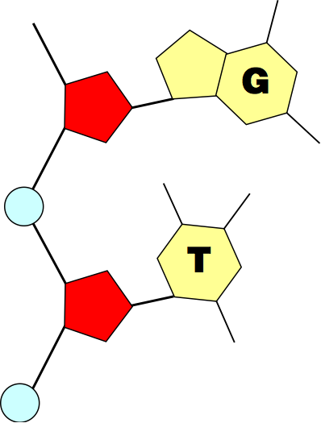
DNA Structure
Phosphates link neighbouring nucleotides together to form one half of a double-stranded DNA molecule:
Purine base (guanine)
Pyrimidine base (cytosine)
Sugar (deoxyribose)
Phosphate
Hydrogen bonds
Purine base (adenine)
Pyrimidine base (thymine)

Slide 15
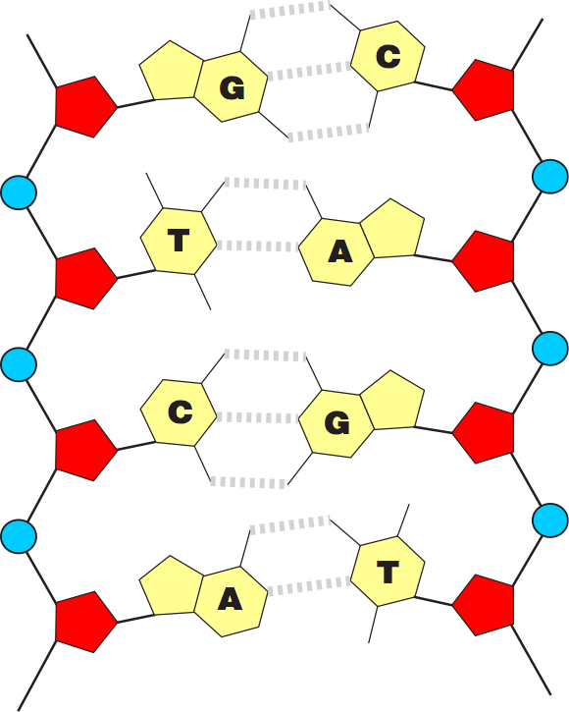
The DNA Molecule
Purines in one DNA strand will always link with pyrimidines in opposing DNA strand.
Hydrogen bonds between the bases form cross-linkages.
This bonding leads to the formation of a double-stranded DNA molecule.
Symbolic representation of a double stranded DNA molecule (right). Note that a double ringed purine will always pair up with a single ringed pyrimidine.
Hydrogen bond

Slide 16
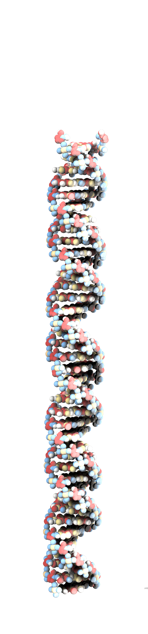
DNA Molecule
Purines join with pyrimidines in the DNA molecule by way of relatively weak hydrogen bonds with the bases forming cross-linkages.
This leads to the formation of a double-stranded molecule of two opposing chains of nucleotides:
The symbolic diagram shows DNA as a flat structure.
The space-filling model shows how, in reality, the DNA molecule twists into a double helix.
Symbolic representation
Space-filling model
Hydrogen bonds

Slide 17
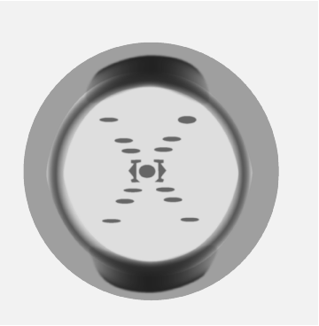
Photo 51
Photo 51 is the X-ray diffraction image of DNA taken by Rosalind Franklin, and passed to Watson and Crick by Maurice Wilkins after he recognised its importance in the search for DNA’s structure.
The image allowed many measurements and observations and led to Watson and Crick’s landmark discovery.
The X shape implies a helix
The clear diamond areas indicate that the regular arrangement of the sugar-phosphate groups in DNA form the backbone of the molecule.
The smears indicate how many units per turn of the helix there are, the length of DNA per turn, and the diameter of the helix.
The “missing smears” are caused by the interference pattern of two helices (not three as many people thought). It also shows there are major and minor grooves in the double helix structure.

Slide 18
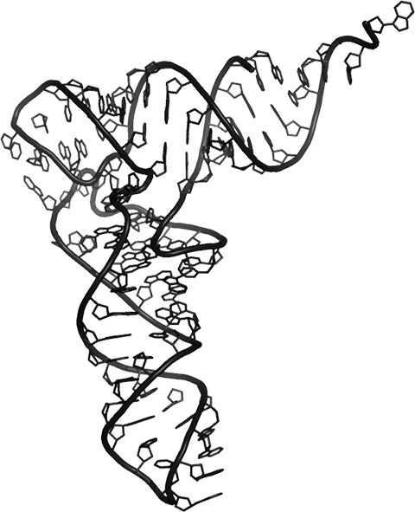
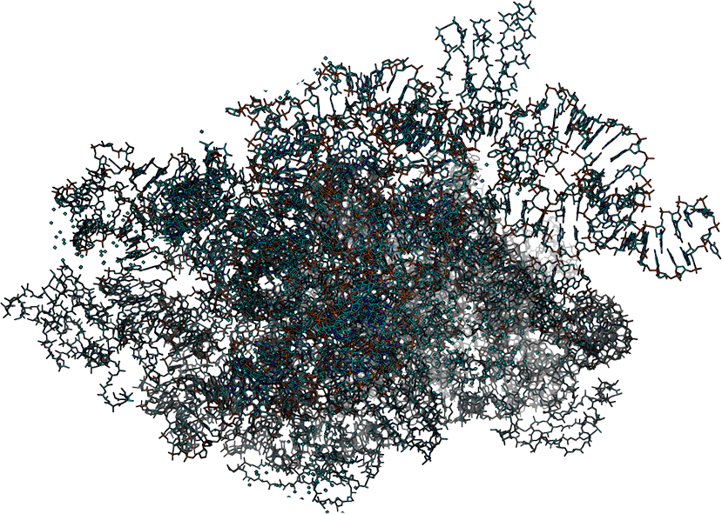
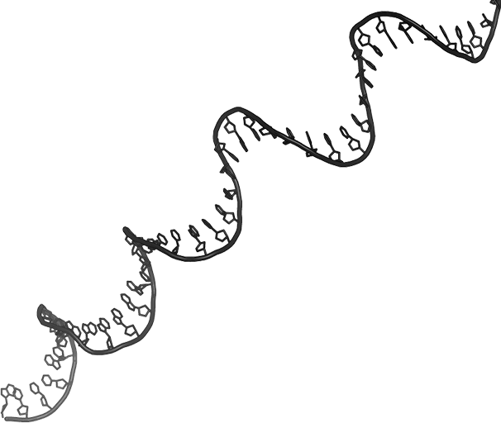
RNA Molecules
Transfer RNA (left) carries amino acids to the growing peptide chain. One end of the tRNA carries the genetic code in a three-nucleotide sequence called the anticodon. The amino acid links to the 3' end of the tRNA.
RNA plays vital roles in transcribing and translating DNA, forming messenger RNA (mRNA), transfer RNA (tRNA), and ribosomal RNA (rRNA).
RNA is also involved in modifying mRNA after transcription and regulating translation.
Regulation of translation is achieved by destroying specific mRNA targets using short RNA lengths, which may be exogenous (short interfering RNAs) or endogenous (microRNAs).
Ribosomal RNA (above) forms ribosomes from two separate ribosomal components (the large and small subunits) and assembles amino acids into a peptide chain.
Messenger RNA (right) is transcribed from DNA. It carries a copy of the genetic instructions from the DNA to ribosomes in the cytoplasm, where it is translated into a polypeptide chain.

Slide 19
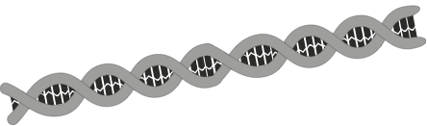
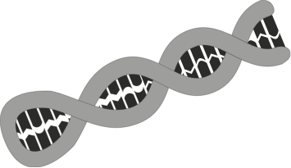
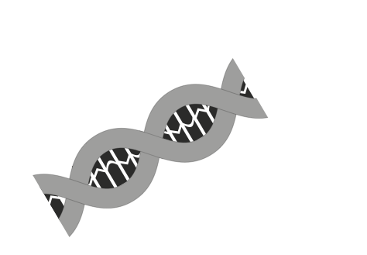


miRNA
Endogenous DNA
Cell nucleus
MicroRNA (miRNA) is formed from hairpin loops of RNA copied from endogenous (within the cell) DNA.
Hairpin loops of ds (double stranded) RNA
The dicer enzyme cuts the hairpin loops into short lengths of miRNA.
miRNA
The RNA induced silencing complex (RISC) is a multiprotein complex that incorporates the miRNA and mediates its unwinding to a form a single stranded miRNA.
The RISC complex binds to a complementary sequence of target mRNA, cleaves it, and so stops its translation.
RISC
miRNA
mRNA
Cleaved mRNA

Slide 20
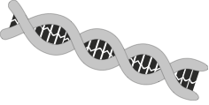
siRNA
Exogenous (outside the cell) double stranded RNA (dsRNA)
Short interfering RNA (siRNA) is formed from exogenous dsRNA, such as the genetic material from a virus.
siRNA
Dicer cuts the dsRNA into siRNA. These are short lengths of dsRNA with a two bp overhang on the 3' end.
RISC
RISC incorporates siRNA to form a complex in the same way as for miRNA. It forms ss siRNA, which can bind to target mRNA.
miRNA
mRNA
The cleaved mRNA is recognised by the cell as abnormal, and is destroyed. This prevents it from being translated.
Cleaved mRNA

Slide 21
The Genetic Code
DNA codes for assembly of amino acids.
The code is read in a sequence of three bases called:
Triplets on DNA
Codons on mRNA
Anticodons on tRNA
Each triplet codes for one amino acid, but more than one triplet may encode some amino acids (the code is said to be degenerate).
There are a few codons that make up the START and STOP sequences for polypeptide chain formation:
START: AUG This is always methionine. Methionine is usually removed from the amino acid chain after translation.
STOP: UAA, UAG, UGA

Slide 22
The Genetic Code
Amino Acid | Codons | No.
Alanine | GCU GCC GCA GCG | 4
Arginine | CGU CGC CGA CGG AGA AGG | 6
Asparagine | AAU AAC | 2
Aspartic Acid | GAU GAC | 2
Cysteine | UGU UGC | 2
Glutamine | CAA CAG | 2
Glutamic Acid | GAA GAG | 2
Glycine | GGU GGC GGA GGG | 4
Histidine | CAU CAC | 2
Isoleucine | AUU AUC AUA | 3
Leucine | UAA UUG CUU CUC CUA CUG | 6
Lysine | AAA AAG | 2
Methionine | AUG | 1
Phenylalanine | UUU UUC | 2
Proline | CCU CCC CCA CCG | 4
Serine | UCU UCC UCA UCG AGU AGC | 6
Threonine | ACU ACC ACA ACG | 4
Tryptophan | UGG | 1
Tyrosine | UAU UAC | 2
Valine | GUU GUC GUA GUG | 4
Two-base codons would not give enough combinations with the 4-base alphabet to code for the 20 amino acids commonly found in proteins (it would provide for only 16 amino acids).
Many of the codons for a single amino acid differ only in the last base. This reduces the chance that point mutations will have any noticeable effect.
The encoded amino acids can be determined from a mRNA-amino acid table

Slide 23
The mRNA-Amino Acid Table
The mRNA-amino acid table decodes the base sequence in the mRNA
Read second letter here
Second letter
Read third letter here
Read first letter here
 | U |  | C |  | A |  | G
U | UUU | Phe | UCU | Ser | UAU | Tyr | UGU | Cys | U
 | UUC | Phe | UCC | Ser | UAC | Tyr | UGC | Cys | C
 | UUA | Leu | UCA | Ser | UAA | STOP | UGA | STOP | A
 | UUG | Leu | UCG | Ser | UAG | STOP | UGG | Trp | G
C | CUU | Leu | CCU | Pro | CAU | His | CGU | Arg | U
 | CUC | Leu | CCC | Pro | CAC | His | CGC | Arg | C
 | CUA | Leu | CCA | Pro | CAA | Gln | CGA | Arg | A
 | CUG | Leu | CCG | Pro | CAG | Gln | CGG | Arg | G
A | AUU | Ile | ACU | Thr | AAU | Asn | AGU | Ser | U
 | AUC | Ile | ACC | Thr | AAC | Asn | AGC | Ser | C
 | AUA | Ile | ACA | Thr | AAA | Lys | AGA | Arg | A
 | AUG | Met | ACG | Thr | AAG | Lys | AGG | Arg | G
G | GUU | Val | GCU | Ala | GAU | Asp | GGU | Gly | U
 | GUC | Val | GCC | Ala | GAC | Asp | GGC | Gly | C
 | GUA | Val | GCA | Ala | GAA | Glu | GGA | Gly | A
 | GUG | Val | GCG | Ala | GAG | Glu | GGG | Gly | G
First letter
Third letter

Slide 24
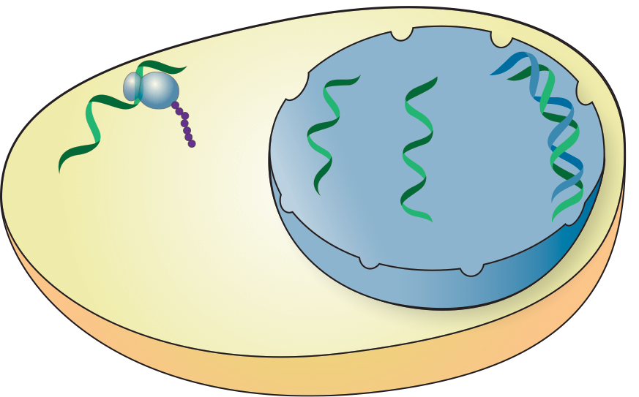
What is Gene Expression?
Gene expression is the process by which the information in a gene is used to synthesise a protein.
It involves transcription of the DNA into mRNA and translation of the mRNA into protein.
In the nucleus, the gene is rewritten into a single stranded primary RNA transcript, using one strand of DNA as a template. RNA polymerase catalyses this process.
Amino acids are linked together at the ribosome to form the protein encoded by mRNA.
Translation
Nucleus
DNA
Editing
mRNA
Ribosome
Transcription
mRNA
Primary transcript
Nuclear pore
Cytoplasm
The primary transcript is edited. The non-protein coding introns are removed and modifications are made to help the mRNA exit the nucleus.

Slide 25
Genes To Proteins
Genes are sections of DNA that code for proteins. Genes are expressed when they are transcribed into messenger RNA (mRNA) and then translated into a protein.
A gene is bounded by a start (promoter) region, upstream of the gene, and a terminator region, downstream of the gene.
These regions control transcription by telling RNA polymerase where to start and stop transcription of the gene. The information flow for gene to protein is shown on below and on the next slide.
Protein coding sequence is transcribed into mRNA by RNA polymerase
The coding strand is not transcribed
5’
3’
3’
5’
Promoter region
RNA polymerase binds
The template strand is the DNA strand that is transcribed
Terminator region
RNA polymerase dissociates
Region of DNA that is transcribed

Slide 26
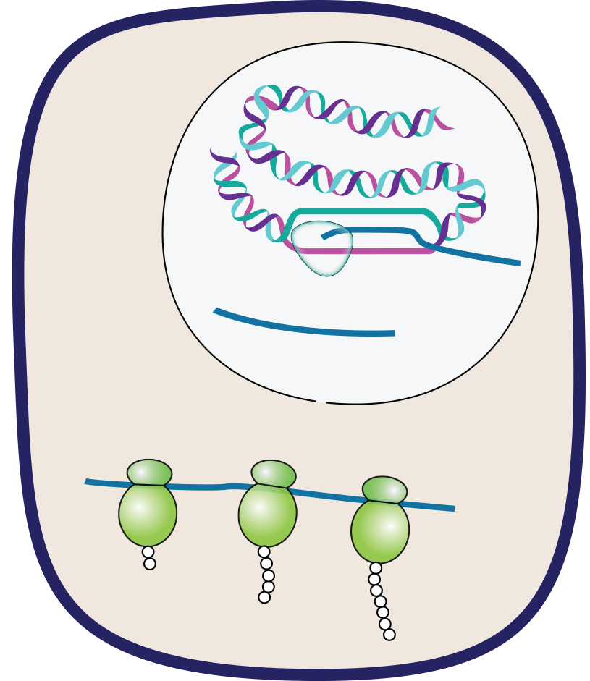
Gene Expression in Eukaryotes
In eukaryotes, primary RNA must be edited and processed before passing from the nucleus to the cytoplasm.
Nucleus
Cytoplasm
DNA
Transcription and processing
RNAP
mRNA
Translation
Polypeptide

Slide 27
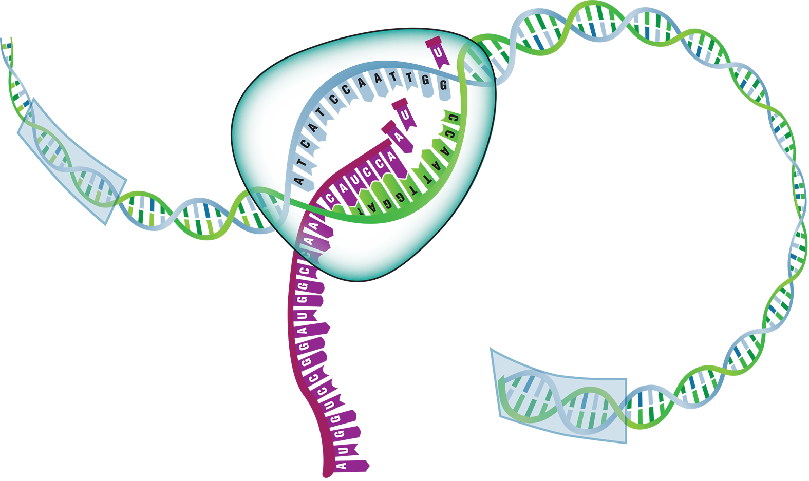
Transcription in Eukaryotes
Transcription is the first stage of gene expression.
It takes place in the nucleus and is carried out by the enzyme RNA polymerase, which rewrites the DNA into a primary RNA transcript using a single template strand of DNA
RNA polymerase adds nucleotides to the 3' end so the strand is synthesised in a 5' to 3' direction.
Coding (sense) strand of DNA
mRNA nucleotides. Free nucleotides are used to construct the RNA strand.
RNA polymerase binds at the upstream promoter region.
Template (antisense) strand of DNA stores the information that is transcribed into mRNA.
Newly synthesised RNA strand is complementary to the template strand
RNA polymerase dissociates at the terminator region
Translation will begin at the start codon AUG

Slide 28
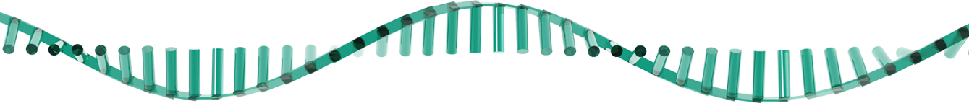
Editing the Primary mRNA
Exons are spliced together to form the mature mRNA. There are several ways in which this is done.
Introns might also facilitate recombination between exons of different genes. This may accelerate evolution.
Exon 1
Intron
Exon 2
Exon 3
Exon 4
Splicing
Exon skipping. During splicing exons may be left out.
Mutually exclusive exons. One of two exons are used but not both.
Intron retention. Introns are not always removed during splicing.
Alternative binding sites. Exons may have more than one cleavage and binding site.
1
2
4
2
3
4
1
I
2
3
4
1
2
3
4
1
3
4
1
2
3
4

Slide 29
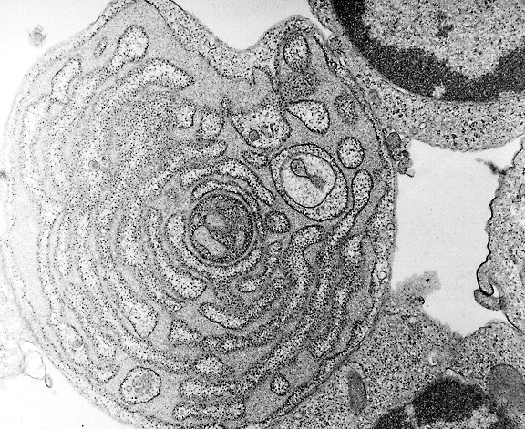
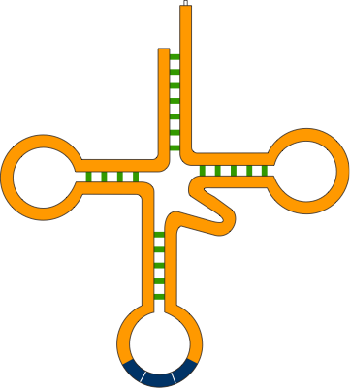

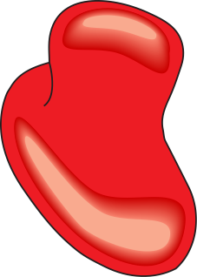
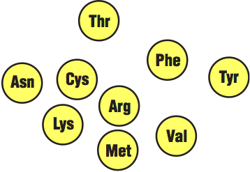
Translation
Translation is the process of building a polypeptide chain from amino acids, guided by the sequence of codons on the mRNA.
Structures involved in translation:
Messenger RNA molecules (mRNA) carries the code from the DNA that will be translated into an amino acid sequence.
Transfer RNA molecules (tRNA) transport amino acids to their correct position on the mRNA strand.
Ribosomes provide the environment for tRNA attachment and amino acid linkage.
Amino acids from which the polypeptides are constructed.
The speckled appearance of the rough endoplasmic reticulum is the result of ribosomes bound to the membrane surface.
mRNA
tRNA
Amino acids

Slide 30

Ribosomes & tRNA
Ribosome
Ribosome
Comprises two subunits in which there are grooves where the mRNA strand and polypeptide chain fit in.
The ribosomal subunits are constructed of protein and ribosomal RNA (rRNA).
The subunits form a functional unit only when they attach to a mRNA molecule.
tRNA molecule
There is a specific tRNA molecule and anticodon for each type of codon.
The anticodon is the site of the 3-base sequence that 'recognises' and matches up with the codon on the mRNA molecule.
Large subunit
Small subunit
Amino acid attachment site
Ribosome attachment point
The 3-base sequence of the anticodon is complementary to the codon on the mRNA molecule
Anticodon
Transfer RNA molecule

Slide 31
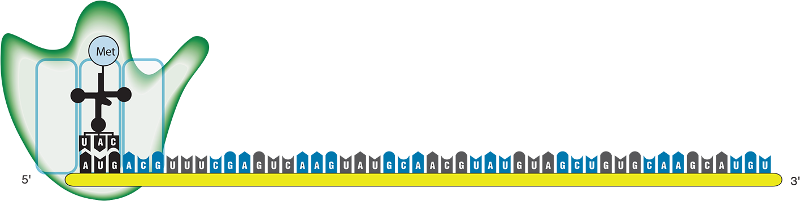
Translation: Initiation
The first initiation stage of translation brings together mRNA, a tRNA bearing the first amino acid of a polypeptide, and the two ribosomal subunits.
The small ribosomal sub-unit attaches to a specific nucleotide sequence on the mRNA strand just ‘upstream’ of the initiation codon (AUG) where translation will start. The initiator tRNA, carrying methionine, attaches to the initiator codon.
The large ribosomal sub-unit binds to complete the protein-synthesising complex.
Ribosome
E
site
P
site
A
site
Ribosomes move in this direction

Slide 32
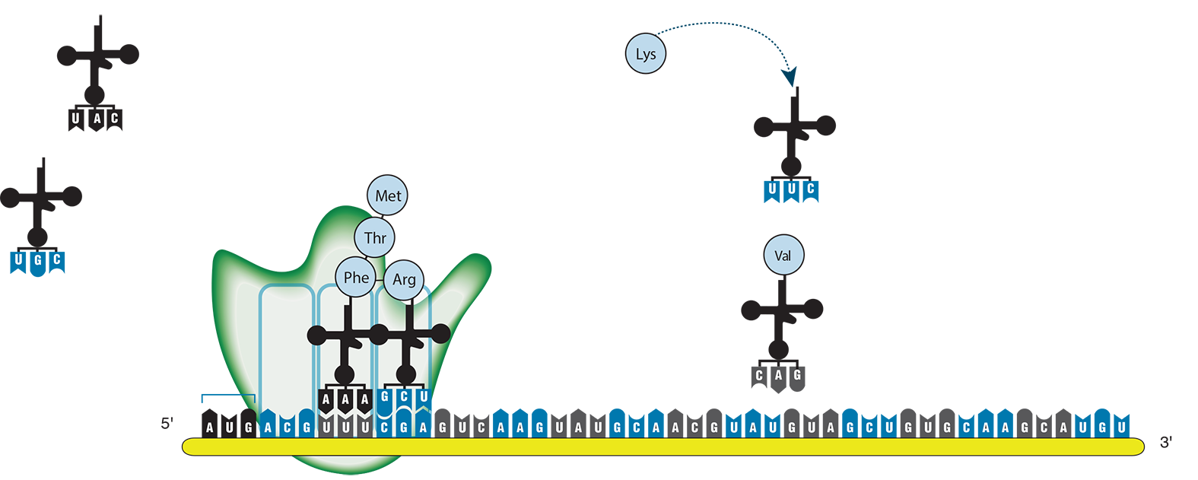
Translation: Elongation
In the elongation stage of translation, amino acids are added one by one by tRNAs as the ribosome moves along the mRNA. There are three steps:
The correct tRNA binds to the A site on the ribosome.
A peptide bond forms between adjacent amino acids.
The tRNA at the P site is released. The tRNA at the A site, now attached to the growing polypeptide, moves to the P site and the ribosome advances by one codon. This step requires energy.
Unloaded Met-tRNA
Charging Lys-tRNA
The ribosome P site carries the growing polypeptide chain
Charged Val-tRNA
Charged Arg-tRNA enters the A site. The amino acid is added to the growing polypeptide chain.
Unloaded tRNA leaves the ribosome E site
Ribosome
E
site
P
site
A
site
Ribosomes move in this direction

Slide 33
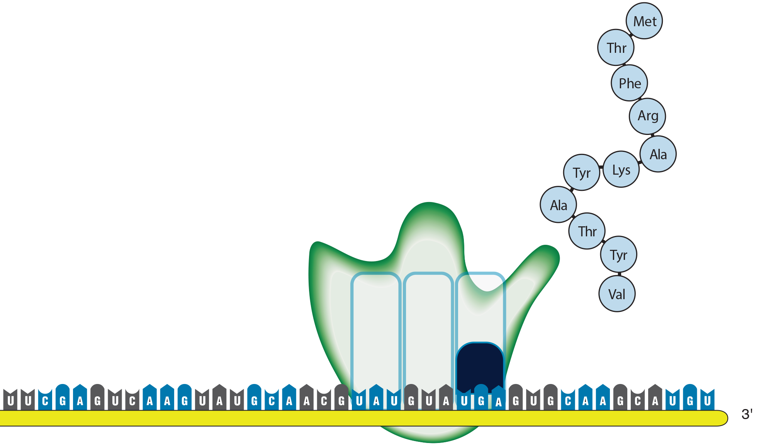
Translation: Termination
The final stage of protein synthesis (termination) occurs when the ribosome reaches a stop codon.
A release factor binds to the stop codon and hydrolyses the completed polypeptide from the tRNA, releasing the polypeptide from the ribosome.
The ribosomal units then dissociate so that they can be recycled.
Completed polypeptide is released
Release factor

Slide 34
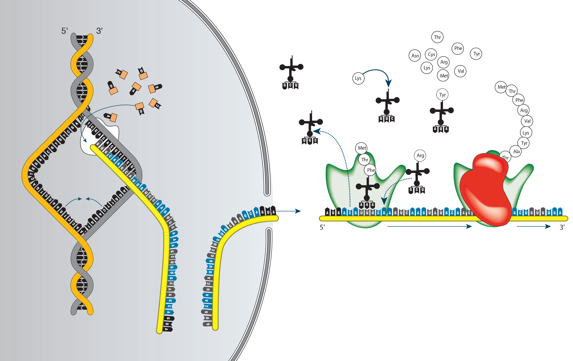
Processes in Protein Synthesis
tRNA recharged with amino acids
Nucleotides added to produce mRNA
Unloaded tRNA
DNA unwinds
RNA polymerase
Primary mRNA
DNA rewinds
tRNA adds amino acid to polypeptide chain
tRNA with amino acid drawn into ribosome
Edited mRNA moves into cytoplasm
Nucleus
Cytoplasm

Slide 35
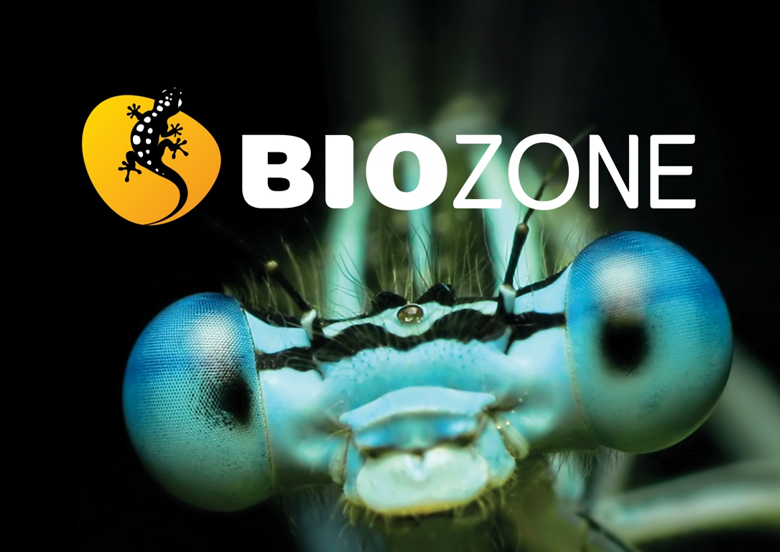

Slide 36
Conditions of Use
NOTE: Presentation Media = presentations available on CD-ROM/DVD-ROM or as downloads
BIOZONE retains copyright to the intellectual property included in the Presentation Media files, with acknowledgement that certain photos are used under license and are credited appropriately.
You MAY:
Use the Presentation Media files for presentations in your classrooms using a data projector, interactive whiteboard or overhead projector.
Place the Presentation Media files on any staff computer within the school, including staff laptops, but not in contradiction to clause (g).
Place the Presentation Media files on:
The school’s intranet (school computer network)
VLE (Virtual Learning Environment)
A CMS (Content Management System).
Student and staff access must be restricted to those who are enrolled/working on the campus of the registered purchaser. Student and staff access to a VLE or a CMS must be controlled by a user login and password protocol, but not in contradiction to clause (f). If students have access, they need to be made aware of the Conditions of Use and are only allowed to view the content.
Edit and customise the Presentation Media files by adding, deleting, and modifying information to better suit your needs, but not in contradiction to clauses 2 (c) - (d).
Print out the Presentation Media files in PowerPoint® or Keynote® “Handouts” mode for the express purpose of allowing students to make their own notes about the presentation, but not in contradiction to clause (e).
You MAY NOT:
Place the Presentation Media files on to the Internet or on a service that may be accessed off-campus unless access to the service is protected by a user login and password protocol, and is restricted to students and staff enrolled/working on the campus of the registered purchaser.
Place the Presentation Media files on student laptop computers.
REMOVE any of the references to BIOZONE, the title slides, copyright notices, photo credits, or Conditions of Use from the Presentation Media files.
Create a NEW document using any of the graphics/images in the Presentation Media files.
Print the Presentation Media files on to paper to make your own worksheets for distribution to students.
Incorporate any part of the Presentation Media files for the production of another commercial product.
Share or give away any content off-campus. This prohibition apples to, but is not limited to, sharing via the Internet or any website, (examples: YouTube, slide sharing websites).
Conditions of Use are subject to change without notice. Visit http://www.biozone.com.au/faqconditionsofuse/

Slide 37
Photo Credits
Photographic images are used under license from the following commercial photo libraries:
Corel Corporation Professional Photos (uncoded)
ArtToday.com (coded AT)
Clipart.com (coded CA)
PhotoObjects.com (coded PO)
iStock.com (coded iStock)
Hemera Technologies Inc. (coded Hemera)
Photos.com (coded PC)
Education interactive (coded EII)
Digital Stock (coded DS)
LifeArt (coded LA)
Dollar Photo Club (coded DPC)
3D models were created using Poser
Additional artwork and photographs are the property of BIOZONE International Ltd. All rights reserved.
Some 2D artwork has been adapted from TechPool STUDIOS LifeArt Collections, used under licence.
Images from the Public Domain: Where these licenses have been used, authors and licenses have been acknowledged alongside their image.
Centers for Disease Control (coded CDC)
National Institutes of Health (coded NIH)
National Aeronautics and Space Administration (NASA)
Images from the public domain include limited copyright, copyright expired, uncopyrighted, or uncopyrightable material:
Licenses including: GNU Free Documentation License http://www.gnu.org/copyleft/fdl.html
Creative Commons Attribution Share Alike http://creativecommons.org/licenses/by-sa/3.0/
Wikimedia Commons
NOTE: Where images are edited or moved from or within this file, the accompanying photo credit must be retained.

Slide 38
